Slide 1


MacroHard User Manual
Team 1
NOVEMBER 2020

Slide 2
Table of Contents
Log-in ________________________________________________________________ Slide 3
SIGN UP _______________________________________________________________ Slide 4
ADMINISTRATOR _________________________________________________________ Slide 5
FACULTY _______________________________________________________________ Slide 6
STUDENT _______________________________________________________________ SLIDE 7
Contact ______________________________________________________________ SLIDE 8

Slide 3


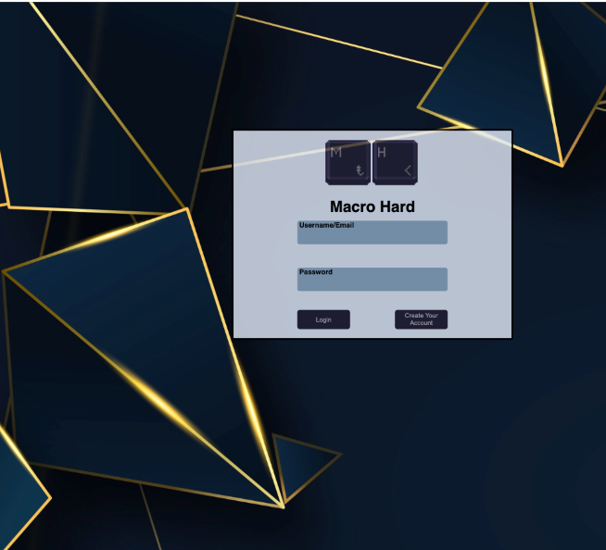
Log-in
TO login to the HOME PAGE ENTER YOUR USER ID AND PASSWORD.
If you do not have an account follow the next steps and create one.

Slide 4
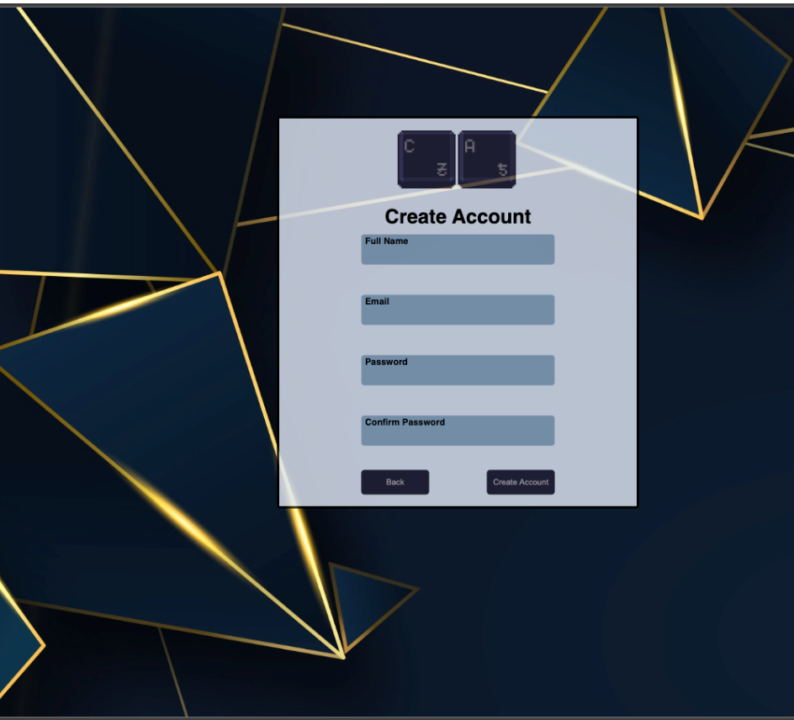
SIGN UP
TO SIGN UP Please CLICK THE ”SIGN UP” Button on the MAIN SCREEN
Next, ENTER THE NECESSARY INFORMATION AND CLICK ”SIGN UP”
The system will automatically associate your account. If a user goes through with this process, will be automatically assigned as general user.

Slide 5
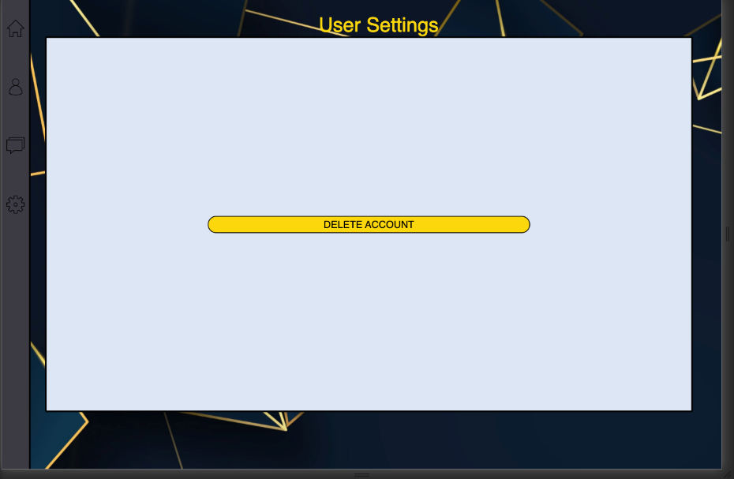
USER SETTINGS PAGE
In the User setting page users can delete their account.

Slide 6
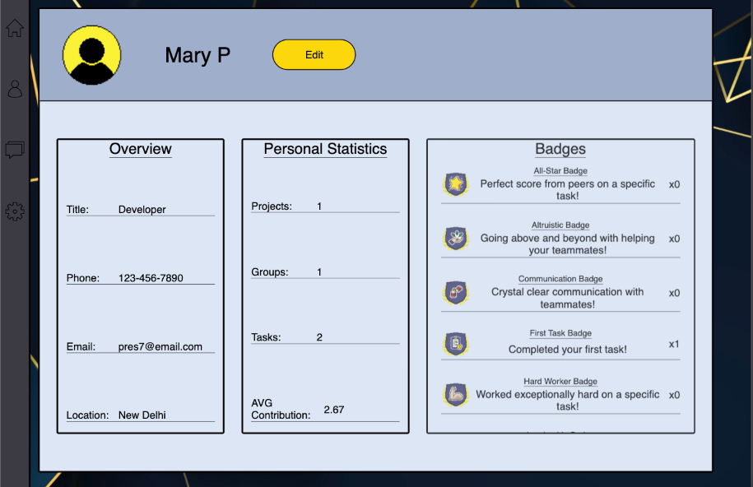
PROFILE PAGE
User can view their profile, which includes general user information, personal statistics, and badges.
User can edit their general information, as well as change their profile image.

Slide 7
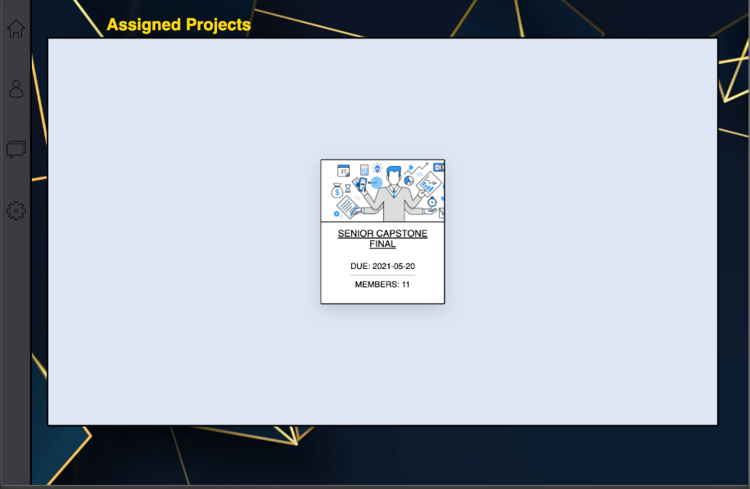
Projects Page
On the Projects page, faculty and general users can see all projects connected to their email.
If faculty member, a button on the bottom of the page appears - allowing a faculty member to create a new project.
Rotating card has Project information and link to access the project.

Slide 8
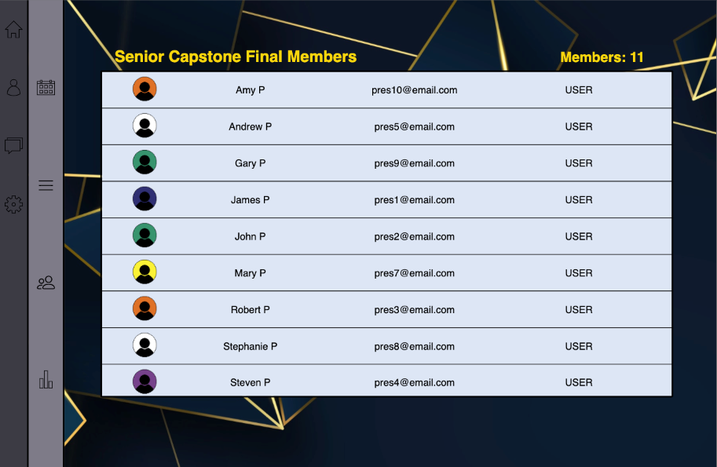
Project members/faculty page
Page displays the names, emails, and user type of every user within project, including self.
Only faculty members can Add/Remove members from their project.

Slide 9
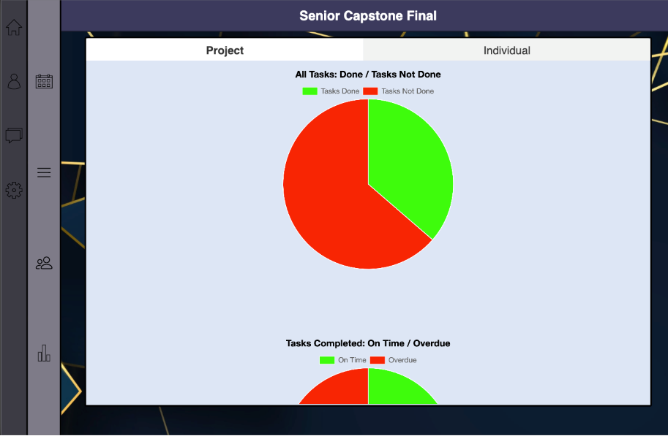
Stats Page Chart Tab Page
On the Stats page, users/faculty can see the progress of the project.
Pie charts include information about tasks within the project:
tasks done/not done
completed tasks overdue/on time
incomplete tasks overdue / not overdue

Slide 10
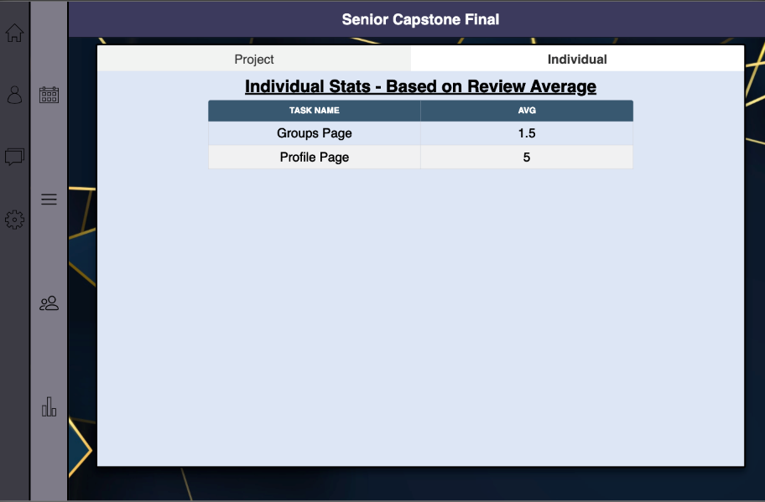
Stats Page Table - Faculty
On the Stats Page ‘Individual’ Tab, averages of review scores are displayed.
For faculty members, they will be able to see all review averages for each member. Includes task name, username, and score.

Slide 11
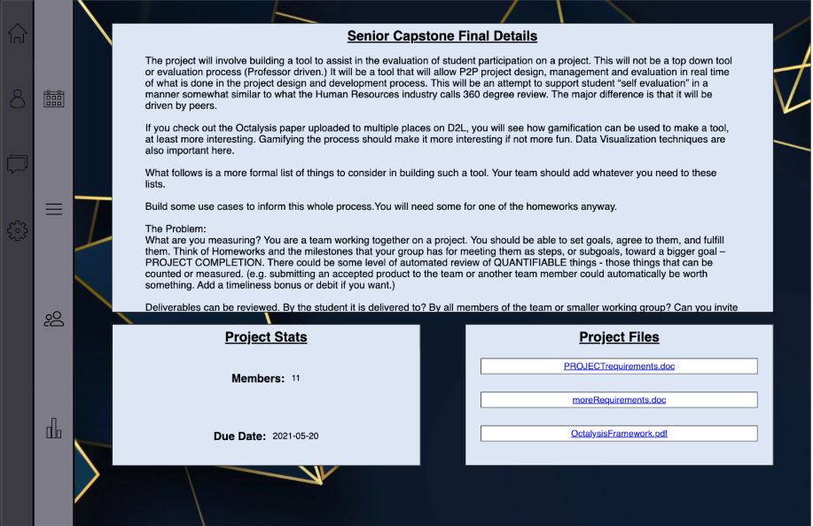
Project Details Page
General Users / Faculty members will be able to see information/stats/files associated with their project.
Users can click project file links to download / use the file for personal use.
Only faculty members will be able to edit the project details or add new project files to the page.

Slide 12
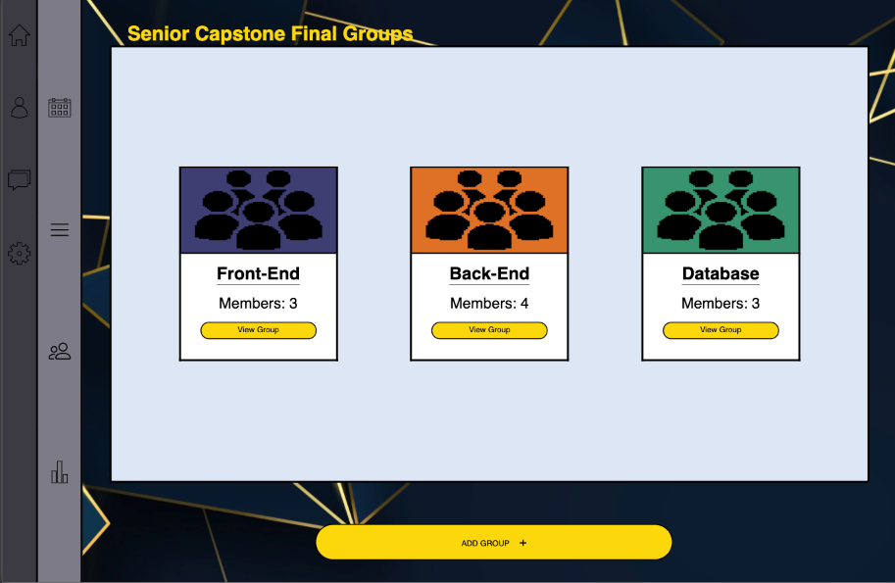
Project groups PAGE
In the Groups page, Users/Faculty can create new groups.
Only Faculty members can remove groups.

Slide 13
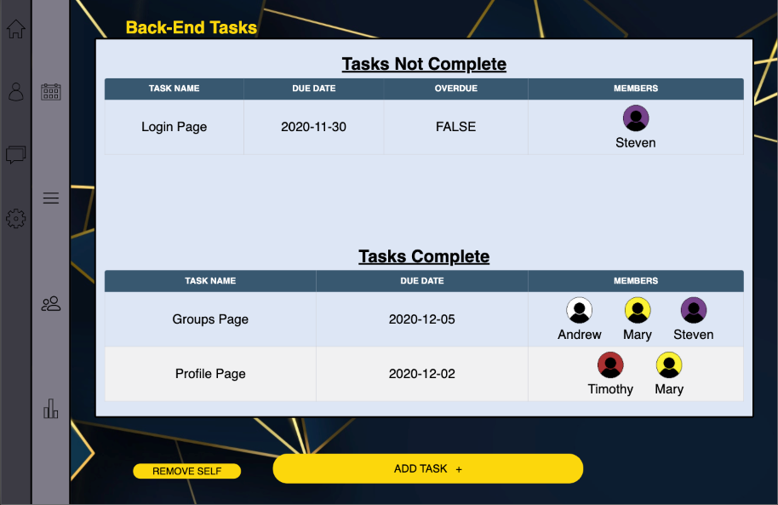
Group tasks
General users and faculty members can create a task to be shared with their group.
Tasks are separated between Complete/Not Complete, prioritizing the not complete tasks at the top.

Slide 14
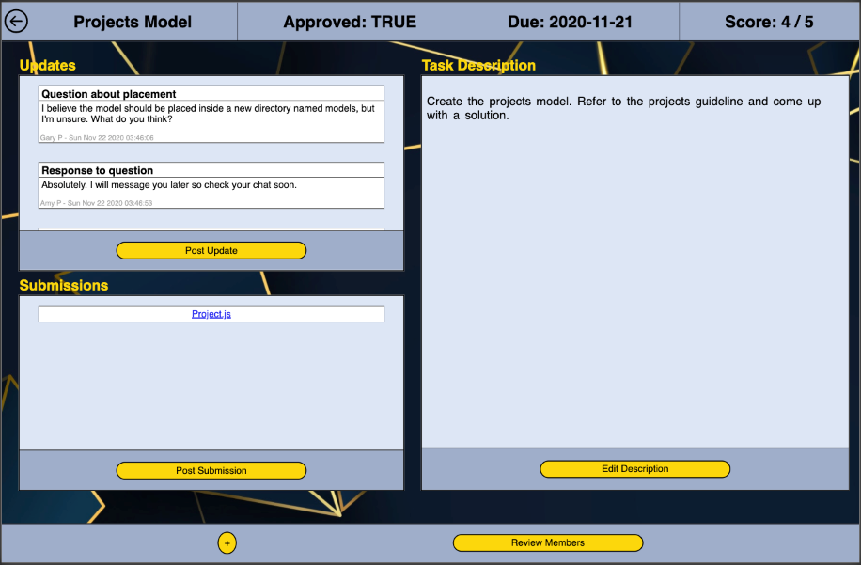
Task PAGE
Users can add or view updates.
Users can see or edit the description of the task.
Users can add or view submissions
Users can add or remove themselves from the task
Task members can change the status of the task to complete or not complete
Once the task is approved by faculty, members can review all members in the task

Slide 15
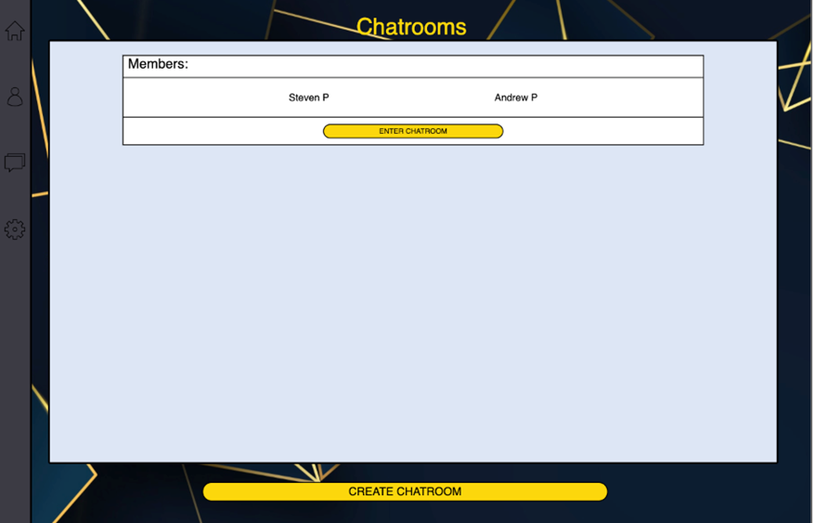
Chatrooms page
Users can create chatrooms using emails associated with the accounts to be added. Click the ‘Add Chatroom‘ button and enter the information within the popup displayed.
Upon creation of chatroom, all users associated to the chatroom will be able to enter and begin chatting.

Slide 16
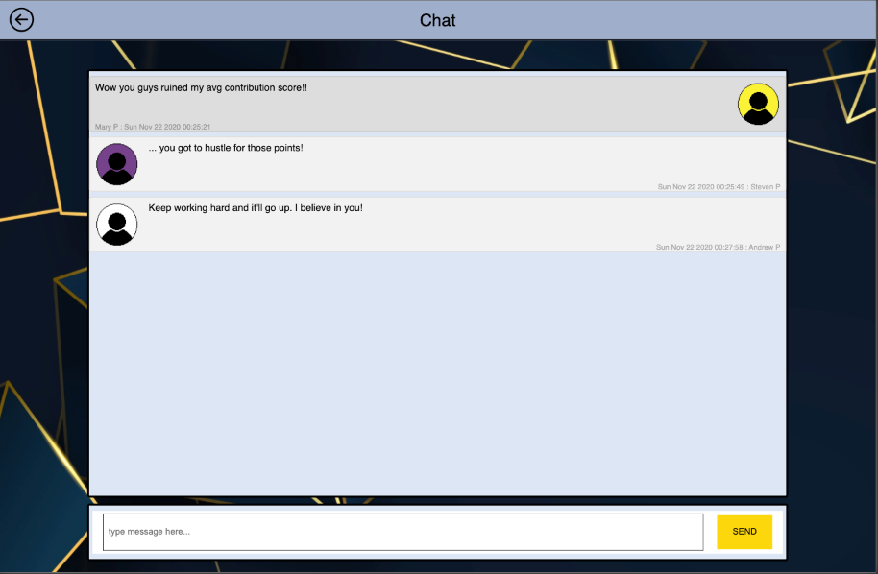
Chat Page
Users can send and receive messages in real-time.
All messages are saved to database upon sending, ensuring all members of chatroom eventually see this message.
Messages are color coded and styled differently and are determined by the sender. (Messages you send are darker and appear right-to-left, everyone else – left-to-right).

Slide 17
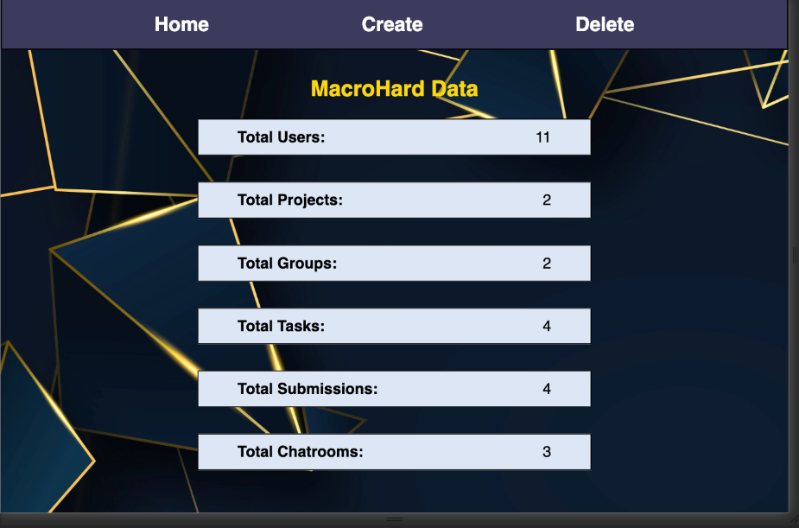
Admin home page
Admin users can see all the information in the database.
Information such as the number of users, projects, groups, tasks, etc.

Slide 18
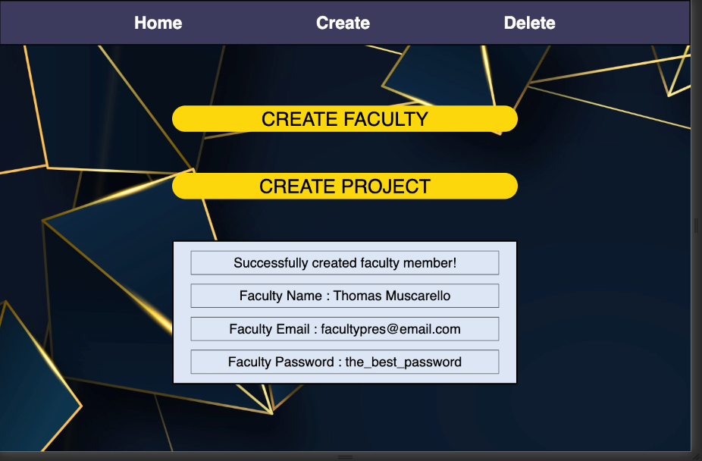
Admin create page
Admins will be able to create faculty users and projects.
Upon entering such information into the popup prompt, a message will display in the textbox signifying whether the creation succeeded / failed.

Slide 19
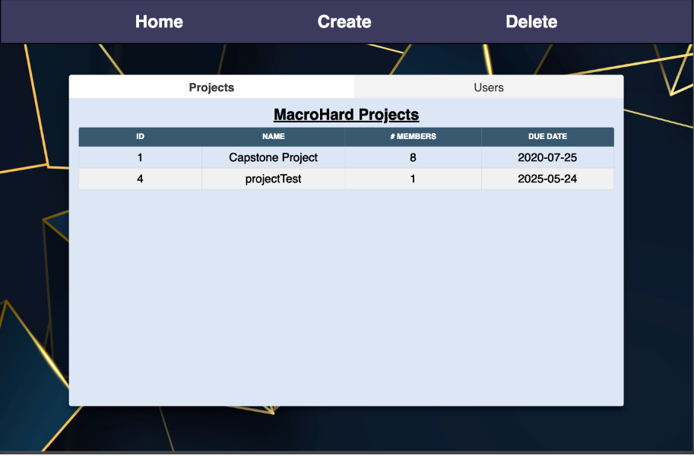
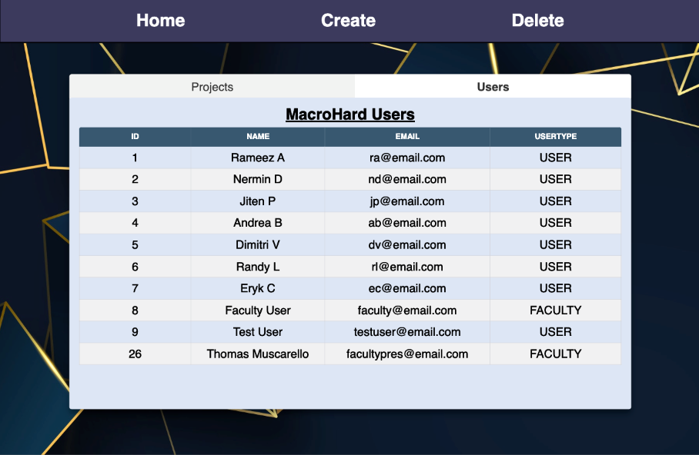
admin delete page
Admins can delete projects or users based on the tab view table selected.
Upon clicking a row, a popup will display and ask the admin to confirm their decision.

Slide 20


CONTACT INFORMATION
For additional questions please contact:
OR EMAIL US AT:
1 (123) 456-7890
macrohard@gmail.com

